Slide 1
MongoDB

Slide 2
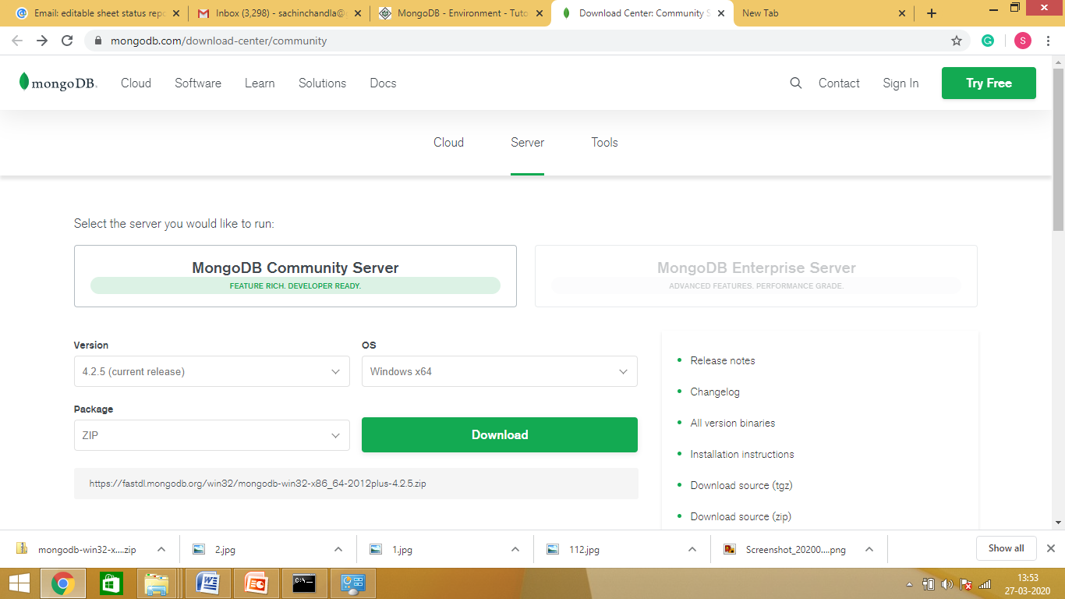
Installation of MongoDB on Windows
First download the latest release of MongoDB from https://www.mongodb.org/downloads

Slide 3
Installation of MongoDB on Windows
Download in ZIP format in C Drive
Unzip / Extract the downloaded file “mongodb-win32-x86_64-2012plus-4.2.5”
Make a new directory with name “mongodb” in C Drive.
Move “Bin” folder and files from “mongodb-win32-x86_64-2012plus-4.2.5” to “mongodb”.

Slide 4
Installation of MongoDB on Windows
MongoDB requires a data folder to store its files.
Create a folder in C drive with name “data” and a sub folder with name “db”.
The default location for the MongoDB data directory is c:\data\db.

Slide 5
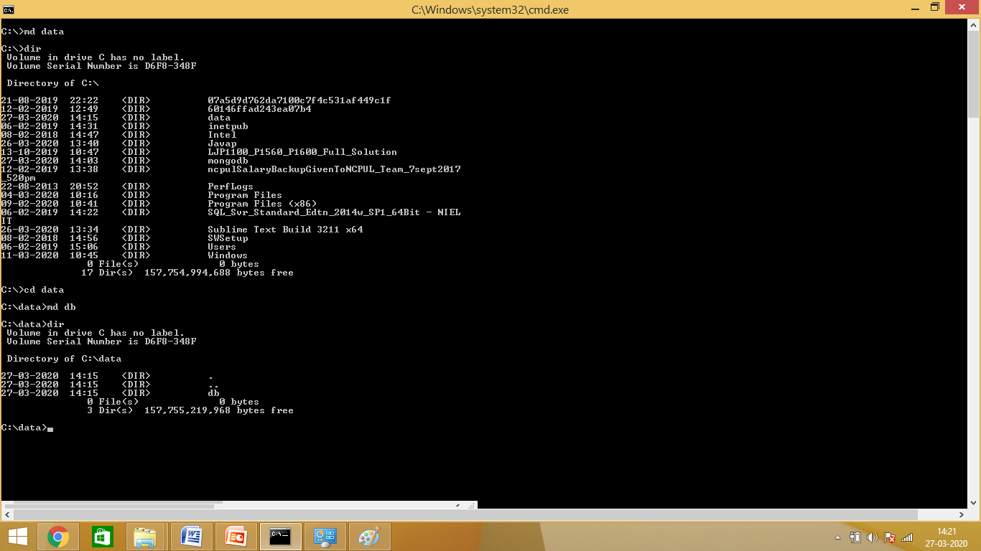
Installation of MongoDB on Windows
Using Command Prompt

Slide 6
Running MongoDB Windows Service
Setting up dbpath in mongod.exe.
In command Prompt
C:\> cd mongodb
C:\mogodb>cd bin
C:\mongodb\bin\mongod.exe - -dpath “c:\data”

Slide 7
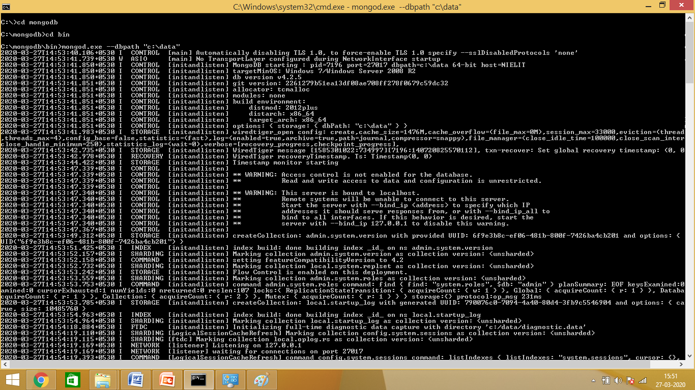
Installation of MongoDB on Windows
Running Status

Slide 8
Running MongoDB Windows Service
Setting of path is to be done for first time only. Next time onwards server is to be started with the following commands.
Go to command prompt than reach upto to bin directory .
For running MongoDB Windows Service
“ C:mongodb\bin\mongod.exe “

Slide 9
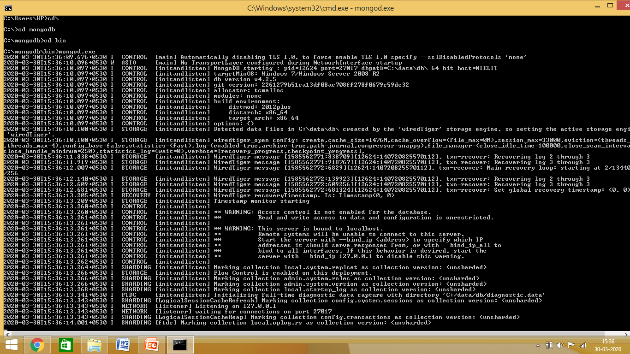
Running MongoDB Windows Service
Running Status
Waiting for Connection Message

Slide 10
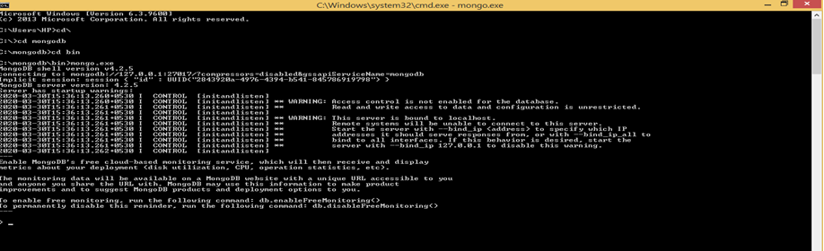
Running Mongo Shell
Open another Command Prompt
Run command
C:\mongodb\bin\mongo.exe

Slide 11
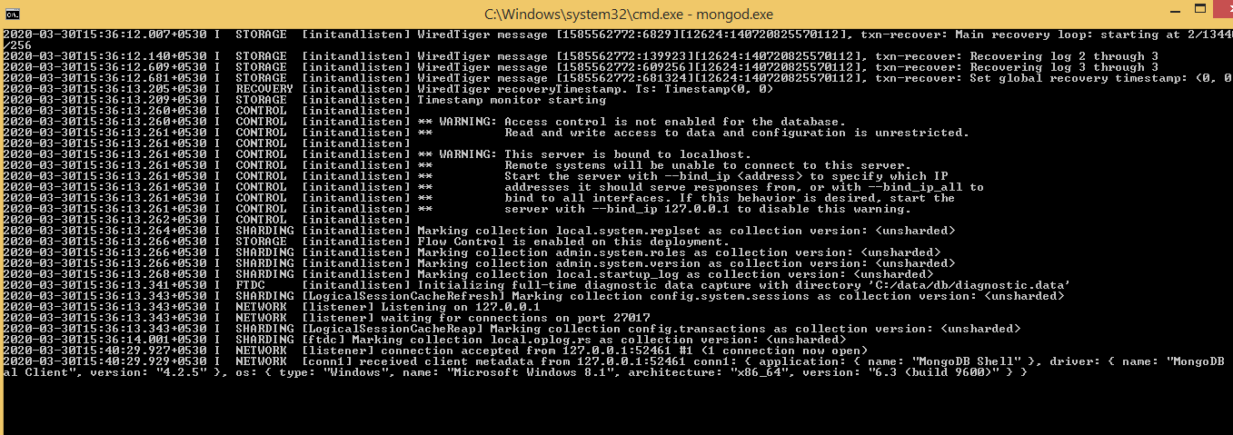
MongoDB Windows Service
Connection Accepted (Message)
1 Connection Now Open (Message)

Slide 12
Starting and Stopping MongoDB
To Start / Restart use command in Command Prompt
“ C:\mongodb\bin\mongo.exe”
To Stop just exit the Command Prompt

